Slide 1
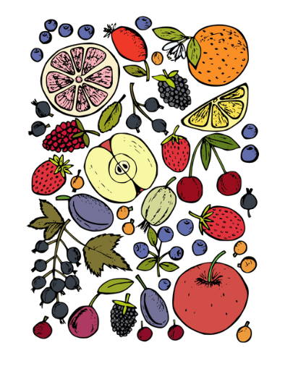

Bizi Fruit
By - Amanda Binu
Salvatore DiMaggio
ITI 200 -Intro to Cloud Computing
Professor: Thiago Ferreira

Slide 2


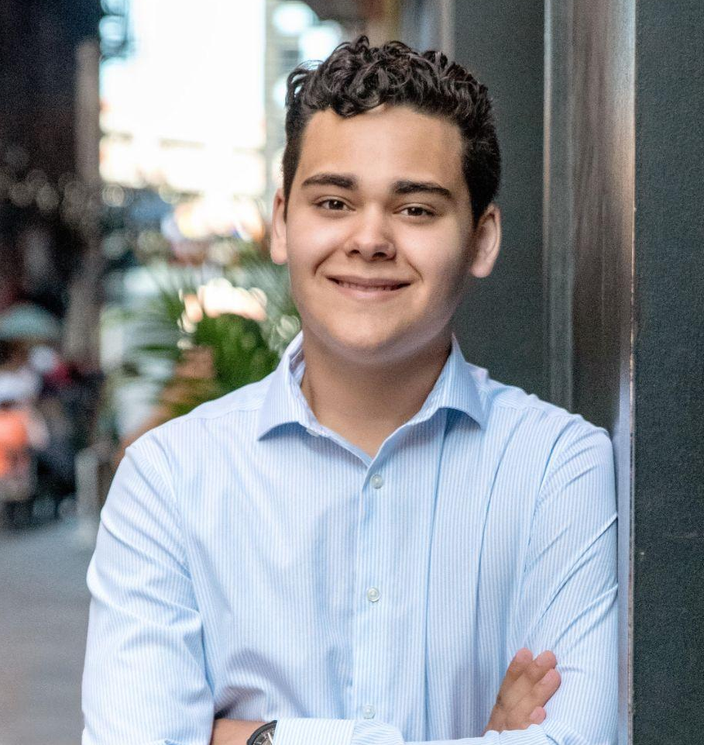
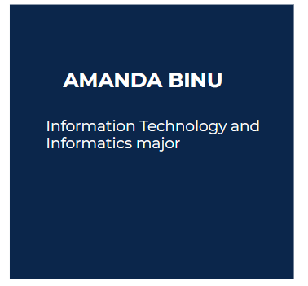
MEET THE TEAM
AMANDA BINU
JUSTIN WAREHAM
Information Technology and Informatics major
Information Technology and Informatics major
SAL DIMAGGIO
Information Technology & Informatics Major, Cybersecurity
Minor: Data Analytics

Slide 3
A lot of people in the United States, do not have the time or money to explore the world and try fruits from different regions of the world.
Notes:
:

Slide 4
SOLUTION
Bizi Fruit ships unique fruit all over the world to the United States making it more accessible to enjoy good quality fruits of all varieties. Many of our fruits come from small organic farms to maintain the authenticity of the regions fruit. Other fruits are imported from countries or states with the best climates suitable for growing the fruit. We specialize in offering fruits that are not common in grocery stores and ship them directly to your door!
Notes:
:

Slide 5
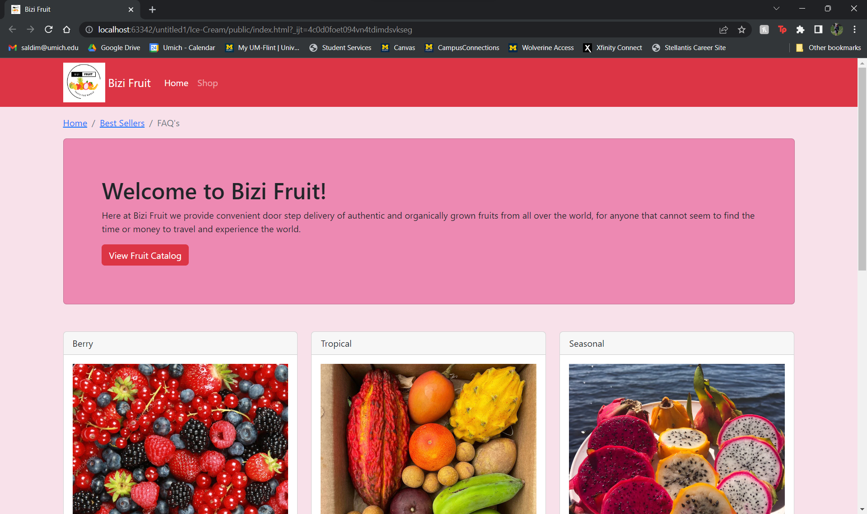
DEMO

Slide 6
LESSONS WE LEARNED
<Divs> are very important for structuring
How to incorporate a back end with a front of a website
How to use bootstrap to create a friendly front end UI for the user
How to use a server to hold data and send it to user by using get requests

Slide 7
ISSUES AND CHALLENGES ENCOUNTERED
Connecting the front end to backend
We had to add cors because the priced would not display on the website from the back end
Accidentally blended express js and vanilla node js together

Slide 8
FUTURE VERSIONS
Bizi Fruit ships worldwide!
Remove the show prices button and just have the prices change when things are added to the order
Future version will have a page to order fruit online and not just a nonfunctional website

